Slide 1




IMPACT OF WEATHER CONDITIONS ON HEALTHCARE
Choy Jee Hung Caleb p2341475

Slide 2
Table of contents
01.
02.
03.
Problem
Statement & Our Aim
Nature of the
datasets
Analysis of the datasets
04.
05.
06.
Transforming of the datasets
Making Predictions
Conclusion

Slide 3

Problem Statement
How does the average daily attendance at polyclinics for specific diseases correlate with prevailing weather conditions?
Can weather-related patterns inform healthcare resource allocation and preparedness strategies for these diseases?
Explore the relationship between the average daily polyclinic attendances for specific diseases and concurrent weather conditions.
Examine historical data on disease-specific clinic visits in relation to meteorological variables.
To identify patterns, trends, and potential weather-driven factors influencing the demand for healthcare services.
Provide provide insights into the impact of weather (such as temperature, rainfall, humidity, and seasonal variations) on disease prevalence and healthcare utilization
Understanding these relationships help in facilitating more informed resource allocation, staffing decisions, and public health planning to enhance the overall responsiveness and efficiency of healthcare systems.

Slide 4



NATURE OF THE DATASETS
LET'S GET STARTED!

Slide 5


Average Weekly Polyclinic Attendances for Selected Diseases Dataset
The dataset captures epidemiological information on different diseases over multiple weeks from year 2012 to year 2022.
Columns of the dataset:
Diseases:
Acute Upper Respiratory Tract infections
Acute Conjunctivitis
Acute Diarrhoea
Chickenpox
HFMD (Hand foot mouth disease)
Epi_week | The epidemiological week in the format YYYY-WW
Disease | The type of disease reported
No._of_cases | The number of reported cases for a specific disease in a given week
Data Peculiarities
Seasonal variations: Observe fluctuations in diseases across different months.
Missing values: There is NaN values found in HFMD

Slide 6
Surface Air Temperature - Monthly Mean Dataset
The dataset captures an overview of the monthly mean temperatures in Singapore from year 1982 to year 2023.
Columns of the dataset:
Month | Recorded in YYYY-MM format
Mean_temp | Monthly mean temperature in degrees Celsius
Data Peculiarities
Seasonal variations: Observe fluctuations in mean temperatures across different months.
Temperature range: Note the temperature range throughout the year.

Slide 7
Rainfall - Monthly Total Dataset
The dataset captures an overview of the monthly mean rainfall in Singapore from year 1982 to year 2023.
Columns of the dataset:
Month | Recorded in YYYY-MM format
Total_rainfall | Monthly total rainfall in millimeters
Data Peculiarities
Seasonal variations: Observe fluctuations in rainfall across different months.
Extreme values: Note the significantly high rainfall in December.

Slide 8
Relative Humidity - Monthly Mean Dataset
The dataset captures an overview of the monthly mean relative humidity in Singapore from year 1982 to year 2023.
Columns of the dataset:
Month | Recorded in YYYY-MM format
Mean_rh | Monthly mean relative humidity as a percentage
Data Peculiarities
Seasonal variations: Observe fluctuations in mean relative humidity across different months.
High values: Note the relatively high humidity during certain months such as December.

Slide 9
Sunshine Monthly Mean Daily Duration Dataset
The dataset captures an overview of the monthly mean sunshine hours in Singapore from year 1982 to year 2023.
Columns of the dataset:
Month | Recorded in YYYY-MM format
Mean_sunshine_hrs | Monthly mean sunshine hours
Data Peculiarities
Seasonal variations: Observe fluctuations in mean sunshine hours across different months.
Low values: Note the relatively low sunshine hours in certain months, particularly December.

Slide 10


ANALYSIS OF THE DATASETS
5 datasets in total

Slide 11
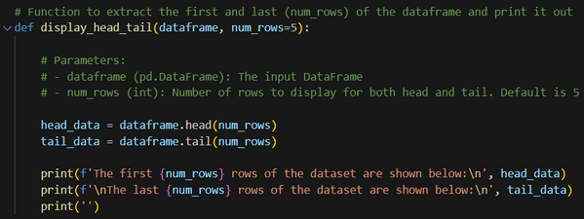
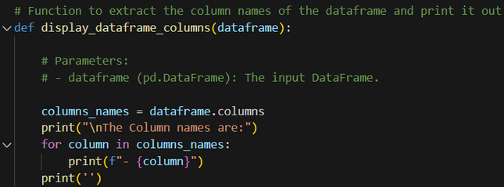
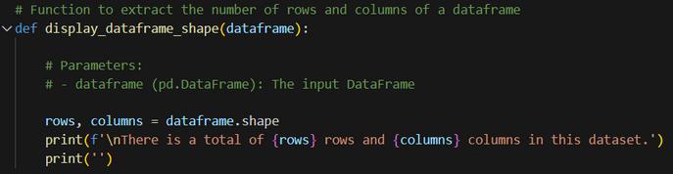
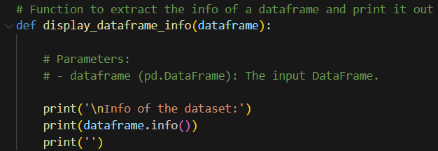
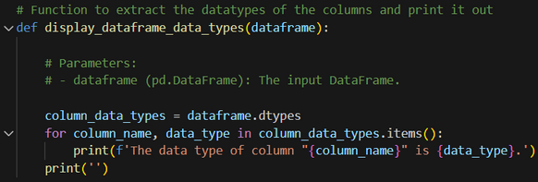
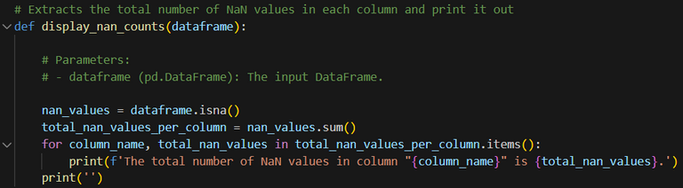
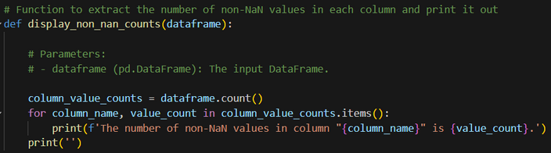

Code used for analysis of the datasets
df.head() and df.tail(): the first/last number of rows
df.columns: Describe DataFrame column
df.shape: Returns (rows, columns)
df.dtypes: Describe the Data types
df.info(): Info on DataFrame
df.isna() and df.sum(): Checks if its a NaN value and sums up the total
df.count(): Returns number of non-NA values

Slide 12
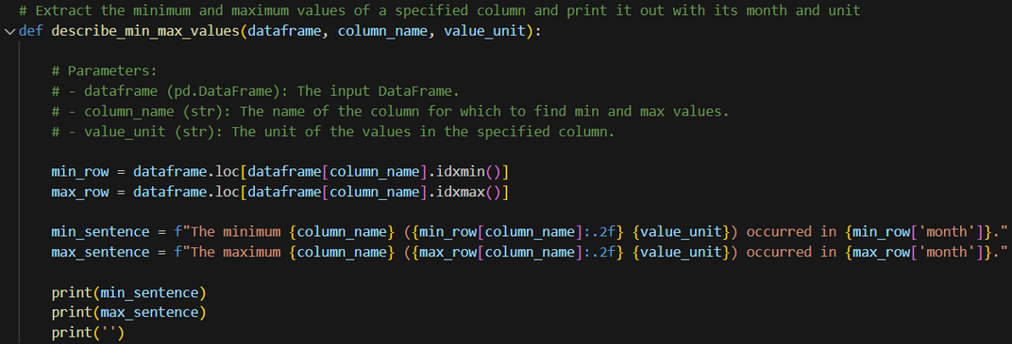
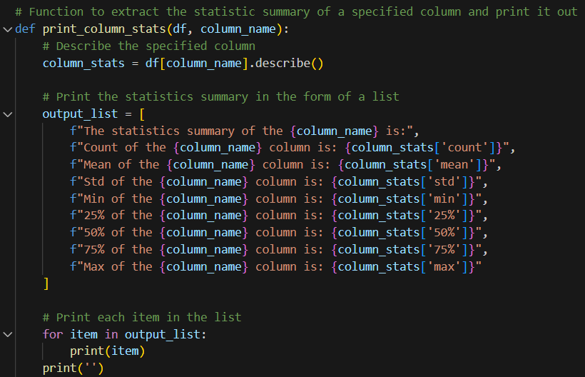
Code used for analysis of the datasets
df.idxmin(), df.idxmax(): Minimum / Maximum Index Value
df.describe: Summary Statistics
df.info(): Info on DataFrame

Slide 13
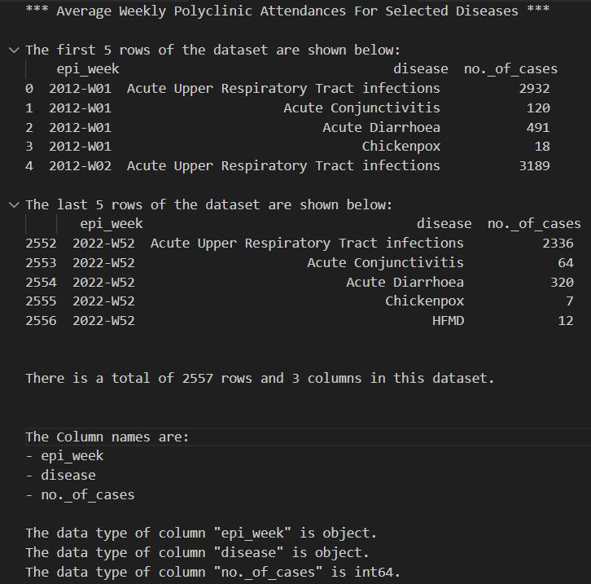
Average Weekly Polyclinic Attendances for Selected Diseases Dataset
From analyzing the original dataset:
Time measurement of the dataset is in epi_week.
Certain weeks such as 2012-w01 is missing the HFMD disease row which would result in NaN values if it was present.
The range of the dataset is from the year 2012 to the year 2022.
There is 2557 rows and 3 columns present.
The column names are epi_week, disease and no_of_cases.
The datatypes are object, object and int64 for epi_week, disease and no_of_cases respectively.

Slide 14
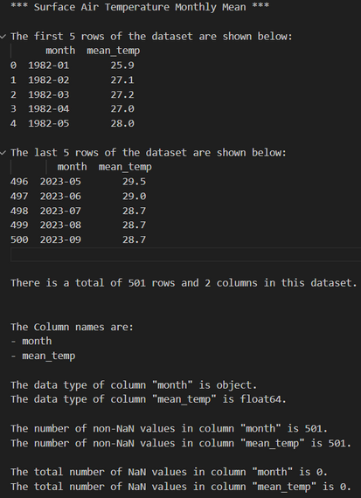
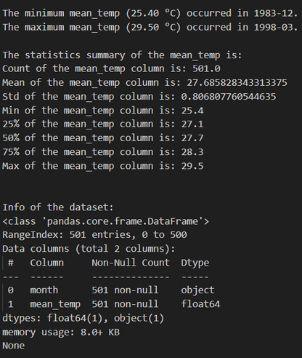
Surface Air Temperature - Monthly Mean Dataset
From analyzing the original dataset:
Time measurement of the dataset is in months.
The range of the dataset is from the year 1982 to the year 2023.
There is 501 rows and 2 columns present.
The column names are month and mean_temp.
The datatypes are object and float64 for month and mean_temp respectively.
There is no NaN values present in either columns.
From analyzing the original dataset:
Minimum-value is 25.40°C in year 1983-12.
Maximum is 29.50°C in year 1998-03.
The statistics summary of the mean_temp can be found as shown on the left.
The info of the dataset can also be observed.

Slide 15
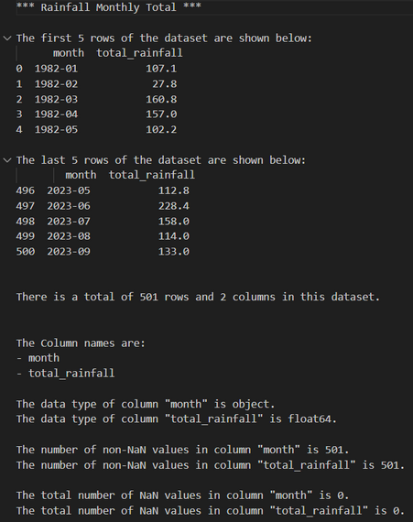
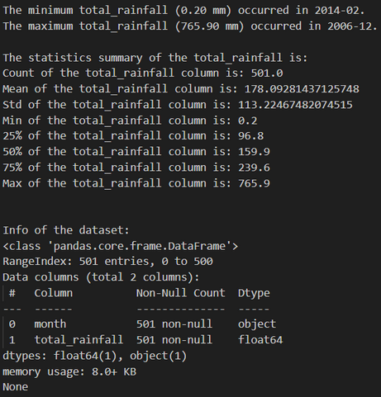
Rainfall - Monthly Total Dataset
From analyzing the original dataset:
Time measurement of the dataset is in months.
The range of the dataset is from the year 1982 to the year 2023.
There is 501 rows and 2 columns present.
The column names are month and total_rainfall.
The datatypes are object and float64 for month and total_rainfall respectively.
There is no NaN values present in either columns.
From analyzing the original dataset:
Minimum-value is 0.20mm in year 2014-02.
Maximum is 765.90mm in year 2006-12.
The statistics summary of the total_rainfall can be found as shown on the left.
The info of the dataset can also be observed.

Slide 16
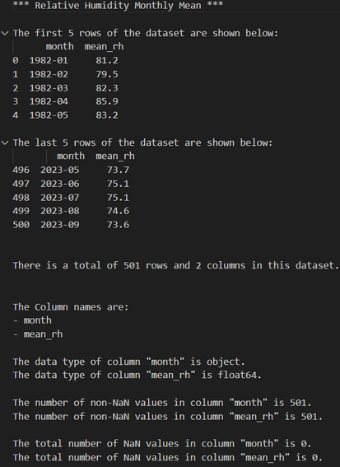
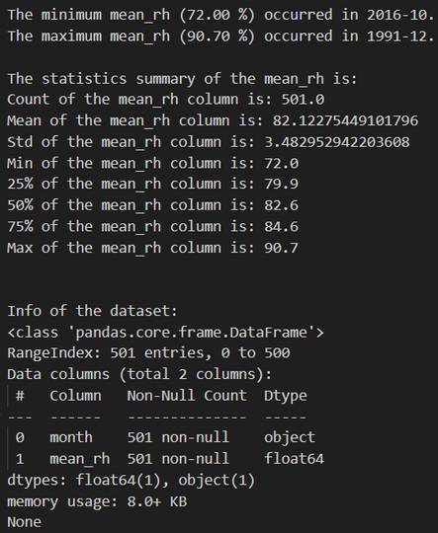
Relative Humidity - Monthly Mean Dataset
From analyzing the original dataset:
Time measurement of the dataset is in months.
The range of the dataset is from the year 1982 to the year 2023.
There is 501 rows and 2 columns present.
The column names are month and mean_rh.
The datatypes are object and float64 for month and mean_rh respectively.
There is no NaN values present in either columns.
From analyzing the original dataset:
Minimum-value is 72.90% in year 2016-10.
Maximum is 90.70% in year 1991-12.
The statistics summary of the mean_rh can be found as shown on the left.
The info of the dataset can also be observed.

Slide 17
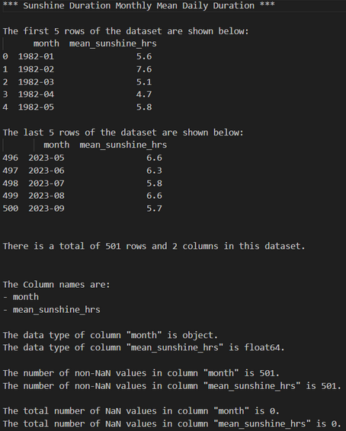
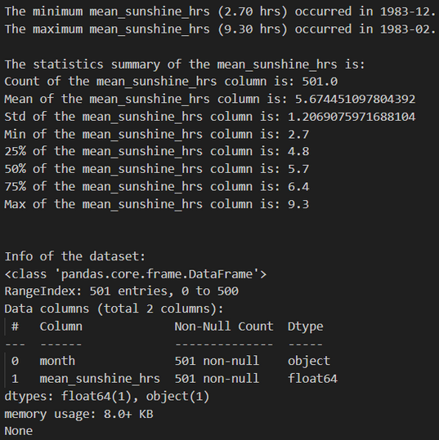
Sunshine Monthly Mean Daily Duration Dataset
From analyzing the original dataset:
Time measurement of the dataset is in months.
The range of the dataset is from the year 1982 to the year 2023.
There is 501 rows and 2 columns present.
The column names are month and mean_sunshine_hrs.
The datatypes are object and float64 for month and mean_sunshine_hrs respectively.
There is no NaN values present in either columns.
From analyzing the original dataset:
Minimum-value is 2.70hrs in year 1983-12.
Maximum is 9.30hrs in year 1983-02.
The statistics summary of the mean_sunshine_hrs can be found as shown on the left.
The info of the dataset can also be observed.

Slide 18
What did we find out from analysis?
From analyzing the original datasets:
The Average Weekly Polyclinic Attendances for Selected Diseases Dataset is in epi_weeks while the other datasets are in months.
We need to convert the epi_weeks to epi_month such that the data can be compared easily.
The Average Weekly Polyclinic Attendances for Selected Diseases Dataset has missing values as seen from the fact that certain weeks are missing the HFMD disease.
The Average Weekly Polyclinic Attendances for Selected Diseases Dataset has timeframe of year 2012 to 2022 while the other datasets have a timeframe of year 1982 to year 2023.
We need to subset the other datasets such that the timeframe of other datasets match the dataset of the Average Weekly Polyclinic Attendances for Selected Diseases Dataset.

Slide 19


TRANSFORMING THE DATA

Slide 20
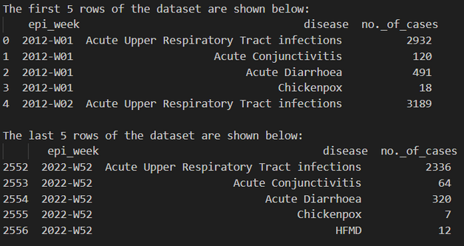
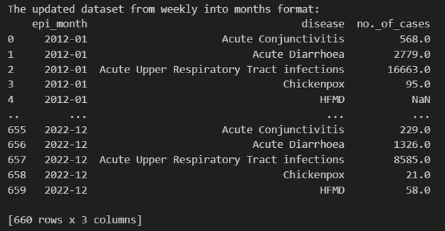
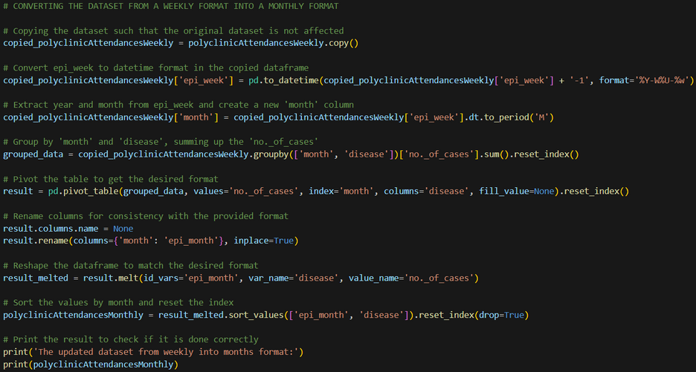
Average Weekly Polyclinic Attendances for Selected Diseases Dataset
The original dataset is in epi_week instead of epi_month as shown.
Therefore, I would need to convert it from a weekly format into a monthly format.
Code used to convert from week to months:
copy() method is used to create a shallow copy of an object
pd.to_datetime is a function used to convert an argument to a datetime object
dt.to_period accessor is used to convert datetime-like objects to a Period
groupby function is used to group rows based on one or more columns
sum() function is used to calculate the sum of values in a DataFrame or Series
reset_index() method is used to reset the index of a DataFrame
pivot_table function is used to create a spreadsheet-style pivot table as a DataFrame
melt function in pandas is used to transform or reshape a DataFrame

Slide 21
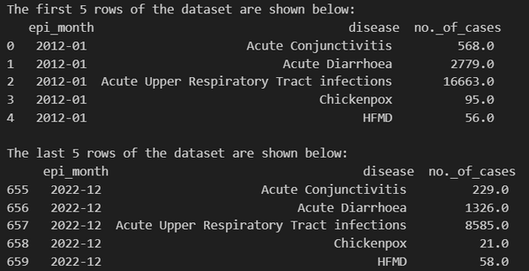
Average Weekly Polyclinic Attendances for Selected Diseases Dataset
We then realize that there is NaN values from no_of_cases column.
Therefore, we would need to resolve the missing values from the column.
Code used to resolve the NaN values:
lambda x: x.fillna(round(x.mean())): A lambda function applied to each group of 'no._of_cases' within each disease group. The lambda function does the following:
x: Represents each group of 'no._of_cases' for a specific disease.
x.mean(): Calculates the mean of the non-null values in the group.
round(x.mean()): Rounds the mean to the nearest integer.
x.fillna(round(x.mean())): Fills missing values in the group with the rounded mean.
.transform(): A pandas method that applies a function to each group of the grouped data and returns a transformed version of the data. In this case, it fills missing values in each group with the rounded mean.

Slide 22
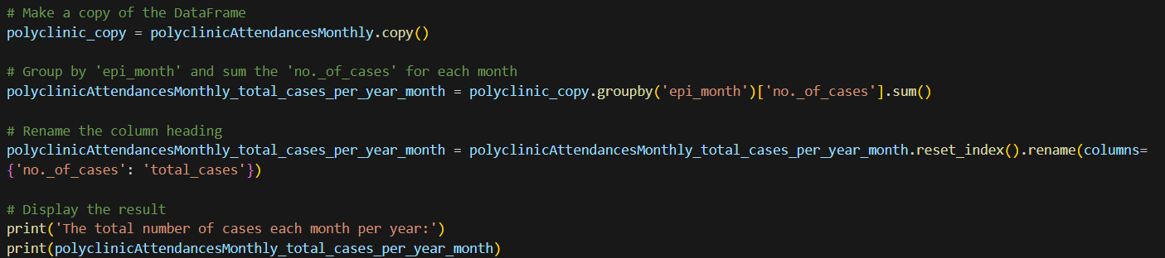
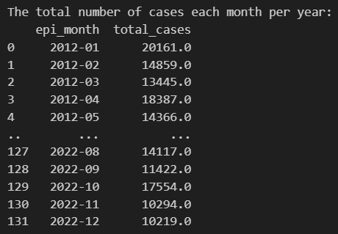
Total cases per month
copy() method is used to create a shallow copy of an object
groupby function is used to group rows based on one or more columns
sum() function is used to calculate the sum of values in a DataFrame or Series
reset_index() method is used to reset the index of a DataFrame

Slide 23
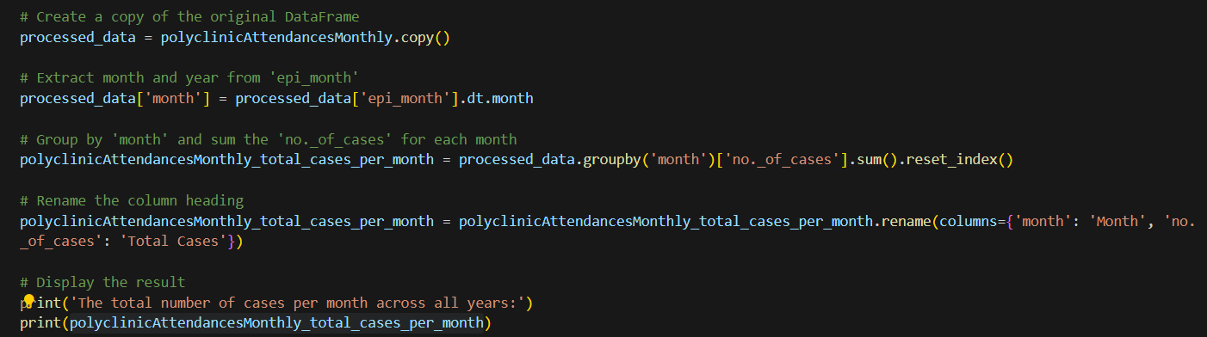
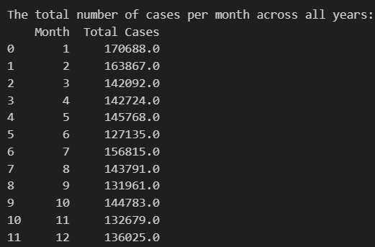
Total cases per specific month added across all years
copy() method is used to create a shallow copy of an object
groupby function is used to group rows based on one or more columns
sum() function is used to calculate the sum of values in a DataFrame or Series
reset_index() method is used to reset the index of a DataFrame

Slide 24
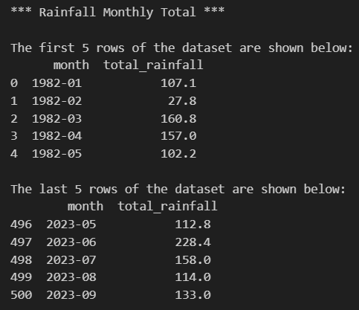
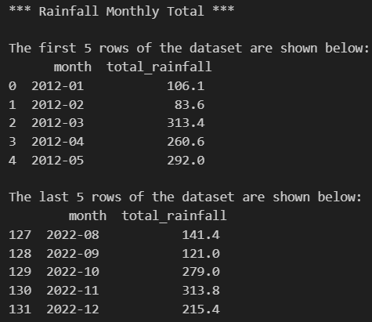
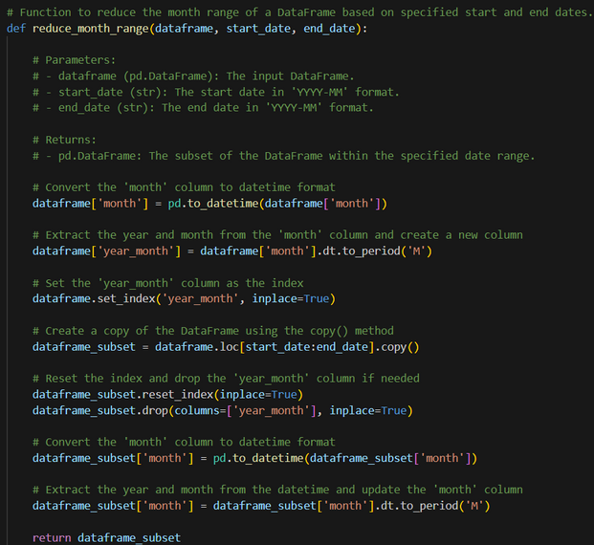
Other datasets
Therefore, I would need to reduce date to match with the attendance dataset of year 2012 to year 2022.
The original datasets has a date range from the year 1982 to the year 2023.
Code used to reduce the timeframe:
copy() method is used to create a shallow copy of an object
pd.to_datetime is a function used to convert an argument to a datetime object
dt.to_period accessor is used to convert datetime-like objects to a Period
sum() function is used to calculate the sum of values in a DataFrame or Series
reset_index() method is used to reset the index of a DataFrame

Slide 25
VISUALIZATION
AFTER TRANSFORM
5 datasets in total

Slide 26
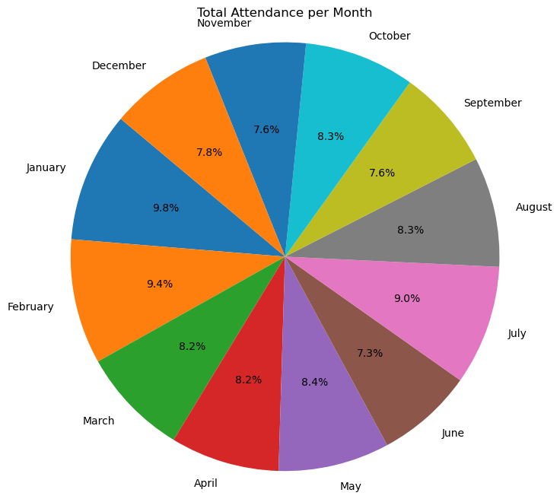
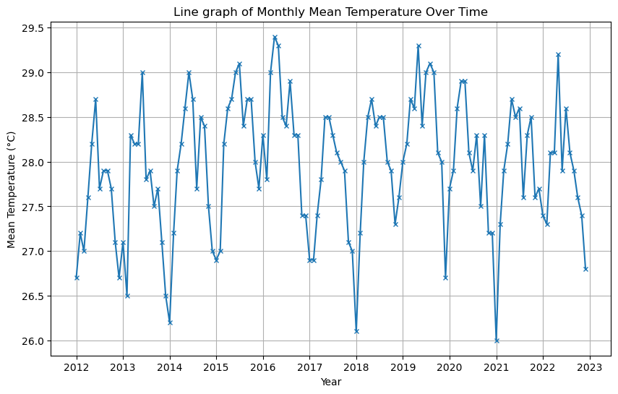
The proportion of the total number of attendances per month can be seen above. There is the large proportion of attendance during January.
The trend is almost identical each year where there is a increase in temperature from January to June, followed by a decrease from June to July and another smaller increase from July to September, followed by another decrease towards December and the cycle then repeats itself.

Slide 27
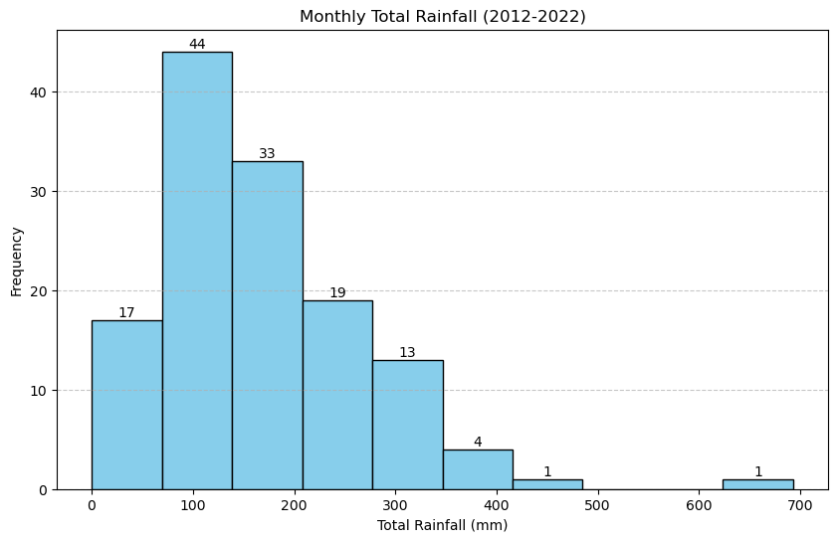
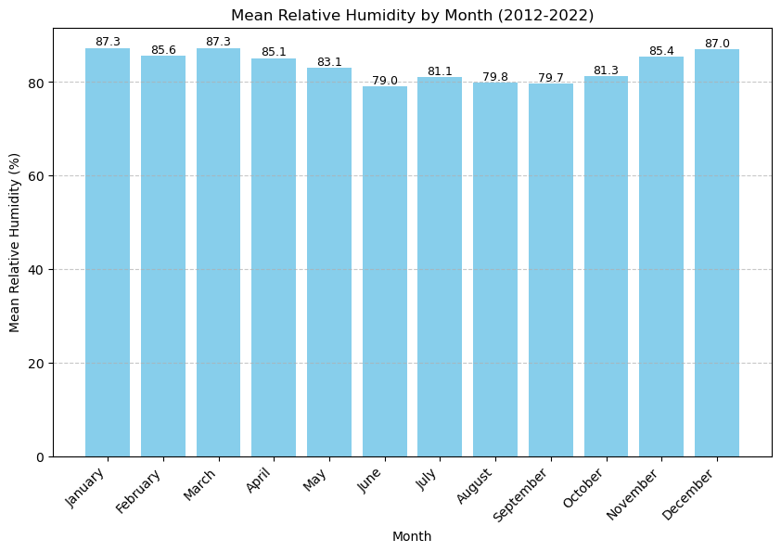
The histogram shows the total amount and frequency of rainfall from the years 2012-2022. It shows us that the mean rainfall across all years is 100mm and that there is an outlier of 700mm of rainfall.
The bar graph shows that the mean relative humidity by month from the year 2012-2022. It shows that there is somewhat of a decrease from January to June and an increase from June to December.

Slide 28
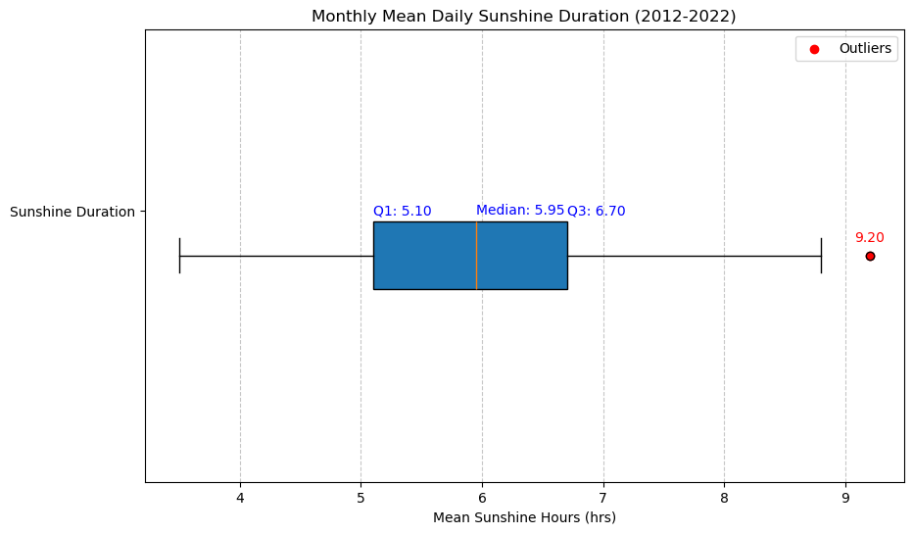
The boxplot shows the monthly mean daily sunshine duration from year 2012-2022.
There is an outlier where the duration is at 9.20hrs and that the 25th percentile and 75th percentile is within 5.10hrs and 6.70hrs.

Slide 29
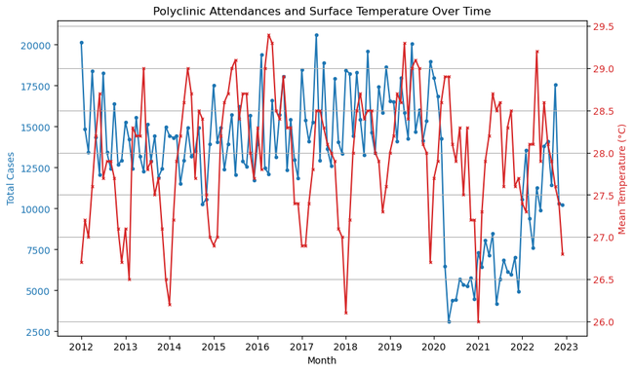
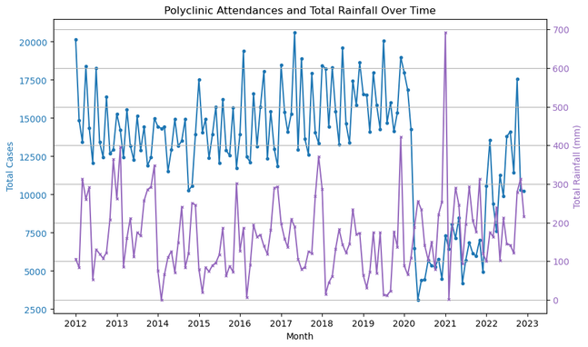
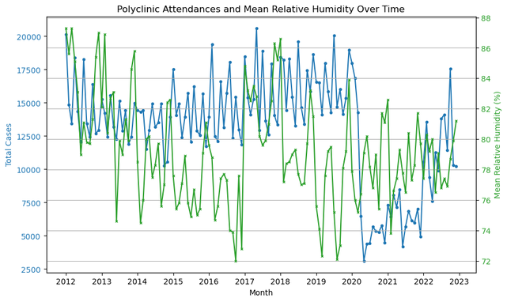
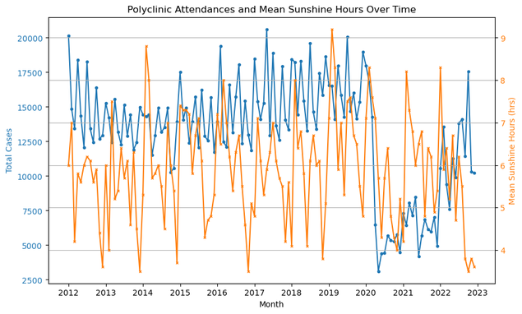
Insights and prediction
These are dual-axis line graphs of number of attendance compared to each of the weather conditions. It shows that there is somewhat of a correlation of polyclinic attendance and the weather conditions. We can then make a prediction that the periods of high polyclinic attendance is during high rainfall, humidity, low temperature and sunshine duration.

Slide 30
Conclusion
In conclusion, the correlation between average daily attendance at polyclinics for specific diseases and prevailing weather conditions might be true but it also can vary based on multiple factors,
geographic location
Certain countries are more temperate, have more rainfall than others, have more density affecting rate of infections.
climate change
Climate change could for example affect temperature
the nature of the diseases in question.
Should other diseases such as cancer be used, there might be no correlation.

Slide 31


THANK YOU

Slide 32
Urls
Average Weekly Polyclinic Attendances for Selected Diseases: https://beta.data.gov.sg/collections/476/view
Surface Air Temperature - Monthly Mean:
https://beta.data.gov.sg/collections/1419/view
Rainfall - Monthly Total:
https://beta.data.gov.sg/collections/1399/view
Relative Humidity - Monthly Mean:
https://beta.data.gov.sg/collections/1404/view
Sunshine Duration- Monthly Mean Daily Duration:
https://beta.data.gov.sg/collections/1417/view

